Slide 1

Name of the student :Sandip Mandal
Name of the student: Md Faisal
Hall ticket Number :22WJ1A05AH
Year/semester :2/2
Subject :SDC-2 LAB PROJECT
Subject code :22SD0CS02
Name of Faculty : Mr. Shiva Shankar Rao Sir
Name of the topic :Bike Rental Booking

Slide 2
Index.html
<!DOCTYPE html>
<html>
<head>
<title>Motorcycle Rental Booking Form</title>
<link rel="stylesheet" href="styles.css">
</head>
<body>
<div class="container">
<h1>Motorcycle Rental Booking Form</h1>
<form>
<div class="form-group">
<label for="name">Name:</label>
<input type="text" id="name" name="name" required>
</div>
<div class="form-group">
<label for="email">Email:</label>
<input type="email" id="email" name="email" required>
</div>
<div class="form-group">
<label for="phone">Phone:</label>
<input type="tel" id="phone" name="phone" required>
</div>
<div class="form-group">
<label for="pickup-date">Pickup Date:</label>
<input type="date" id="pickup-date" name="pickup-date" required>
</div>
<div class="form-group">
<label for="return-date">Return Date:</label>
<input type="date" id="return-date" name="return-date" required>
</div>
<div class="form-group">
<label for="ADDRESS PROOF">ADDRESS PROOF:</label>
<input type="TEXT" id="ADDRESSPROOF" name="ADDRESSPROOF"
required>

Slide 3
required>
</div>
<div class="form-group">
<label for="ADVANCE AMOUNT">ADVANCE AMOUNT:</label>
<input type="text" id="advance amount" name="advance amount"
</div>
<div class="form-group">
<label for="motorcycle-type">Motorcycle Type:</label>
<selectid="motorcycle-type" name="motorcycle-type" required>
<option value="">Select Motorcycle Type</option>
<option value="sports">Sports</option>
<option value="cruiser">Cruiser</option>
<option value="touring">Touring</option>
</select>
</div>
<div class="form-group">
<label for="additional-equipment">Additional Equipment:</label>
<input type="checkbox" id="helmet" name="additional-equipment"
value="helmet"> Helmet
<inputtype="checkbox" id="jacket" name="additional-equipment" value="jacket">
Jacket
<input type="checkbox" id="gps" name="additional-equipment"
value="gps"> GPS
</div>
<div class="form-group">
<label for="special-requests">Special Requests:</label>
<textarea id="special-requests" name="special- requests"></textarea>
</div>
<button type="submit">Book Now</button>
</form>
</div>
</body>
</html>

Slide 4
Main.css
body {
font-family:Arial,sans-serif; background
color: #ccdd82; margin: 0;
padding: 0;
}.container {
width: 100%;
max-width: 600px; margin:
50px auto; padding: 20px;
background-color: #ce5656;
box-shadow: 0 0 10px rgba(0, 0, 0, 0.1);
}
h1 {
text-align: center; color:
#333333; margin-bottom:
30px;
}
.form-group {
margin-bottom: 20px;
}
label {
display: block; font
weight: bold; margin
bottom:5px; color:
#333333;
}
input[type="text"],
input[type="email"],
input[type="tel"],
input[type="date"], select,
textarea {
width: 100%; padding:
10px;
border: 1px solid #dddddd; border

Slide 5
radius: 4px;
box-sizing:border-box; font
size: 16px; color: #333333;
}
textarea {
height: 100px; resize:
vertical;
}
input[type="checkbox"]{
margin-right: 10px;
}
button[type="submit"]{
display: block; width:
100%; padding: 15px;
background-color:#007bff; color: #ffffff;
border: none; border
radius:4px; font-size:
18px; cursor: pointer;
margin-top: 20px;
}
button[type="submit"]:hover {
background-color:#0056b3;
}
@media (max-width: 600px) {
.container {
padding: 15px;
}
h1 {
font-size: 24px;
}
button[type="submit"]{ font
size: 16px;
}
}

Slide 6
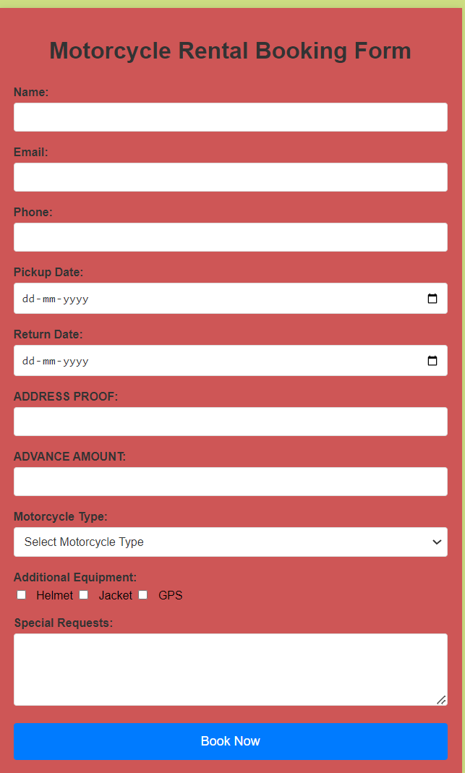
RESULT:

